Slide 1


Endocrine Disruption and Immune Dysfunction
1
Rodney Dietert
Cornell University
January 8, 2014 CHE Presentation
contact: rrd1@cornell.edu

Slide 2
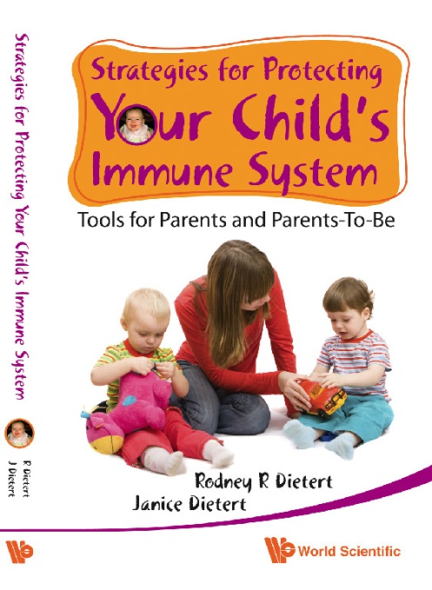
EDCs are a Significant Hazard
for the Developing Immune System
2
EDCs and DIT
Dose sensitivity
Persistence
Spectrum of effects
Latency
The majority of
risk factors
we discuss in this
book are…… EDCs.
Available
Amazon.com
paperback and Kindle

Slide 3
Outline
3
Endocrine disrupting chemicals (EDCs) as a priority health threat for non-communicable diseases (chronic diseases and conditions)
The role of EDCs in developmental immunotoxicity (DIT) and immune dysfunction
Misregulated inflammation as the foundation bloc that connects EDCs to networks of chronic diseases
Inadequacy of current safety testing to protect us from environmentally-induced chronic diseases.

Slide 4
The Landscape of Endocrine Disrupting Chemicals (EDCs)
4
Endocrine disruptors are chemicals that may interfere with the body’s endocrine system and produce adverse developmental, reproductive, neurological, and immune effects in both humans and wildlife. – (NIEHS, Dec. 2013)
Approximately 1,000 potential EDCs have been identified .
- (The Endocrine Disruption Exchange [TEDX], Dec. 2013)
They can be found among: household products, personal care products, food, flame retardants, pesticides, plastic and rubber products, antimicrobials, metal mixtures, industrial additives, solvents, metabolites of other chemicals, and biogenic compounds. – (TEDX, Dec., 2013)
EDCs are active at very low doses (non-monotonic dose-response curves).
EDC-linked dysfunction has been reported for virtually every organ and tissue of the body.

Slide 5


Act Now to Protect Against EDCs: Direct Prenatal Exposure to EDCs Can Produce a
Century of Developmentally-Programmed Disease
5
Timeline/Years
Pregnant Woman Exposed to EDCs
0
F1
Both somatic and germ-line fetal cells are exposed
35
EDC-induced epigenetic
alterations are
present in the F2
F2
70
The 65 yr. old F2 woman
could experience
an adult-onset chronic disease or condition linked to an EDC exposure of germ cells from 100 years earlier.
Lupus
CDV
Osteoporosis
Frailty?
100
Adapted from Dietert, Transgenerational Epigenetics of EDCs, in press

Slide 6

1,000 EDCs across different chemical categories
6
Multiple Pathways and Forms of Endocrine Disruption
Can these be simplified?
(Misregulated
Inflammation)
A Myriad of Disparate Tissue-Related Chronic Diseases and Conditions

Slide 7
7
NIH Examination of the Inflammation-Chronic Disease Link
NIH STEP Forum
STEP - Inflammation: The Root and Route of Chronic Diseases?
(HHS Only)
Tuesday, November 15, 2011
Jerry Phelps, Rodney Dietert, Charles Serhan and David Mosser
441 views (276 live, 165 VOD)
NIEHS Partnership for Environmental Public Health
PEPH Webinar - Connecting Environmental Exposures to
Chronic Inflammation and Diseases
February 28th, 2012 – 12:00 to 1:30 p.m. ET
Webinar Summary (337KB)
NIEHS Calendar

Slide 8
8
Non-Communicable Diseases (i.e., Chronic Diseases) are the Number One Health Threat and Most Likely Adverse Outcomes Following EDC Exposure
  The Number #1 Cause of Mortality Worldwide (63%)*
  Most Chronic Diseases are Increasing in Prevalence
  They Dramatically Impact Quality of Life
  Estimated to Cost 48% of Global GDPs by 2030*
  45.3% of all US adults age 65 and above have two or more chronic diseases: a 20% increase from the previous decade.*
*Joint 2011 report: Harvard School of Public Health and World Economic Forum
and NCHS Data Brief Number 100, July 2012

Slide 9
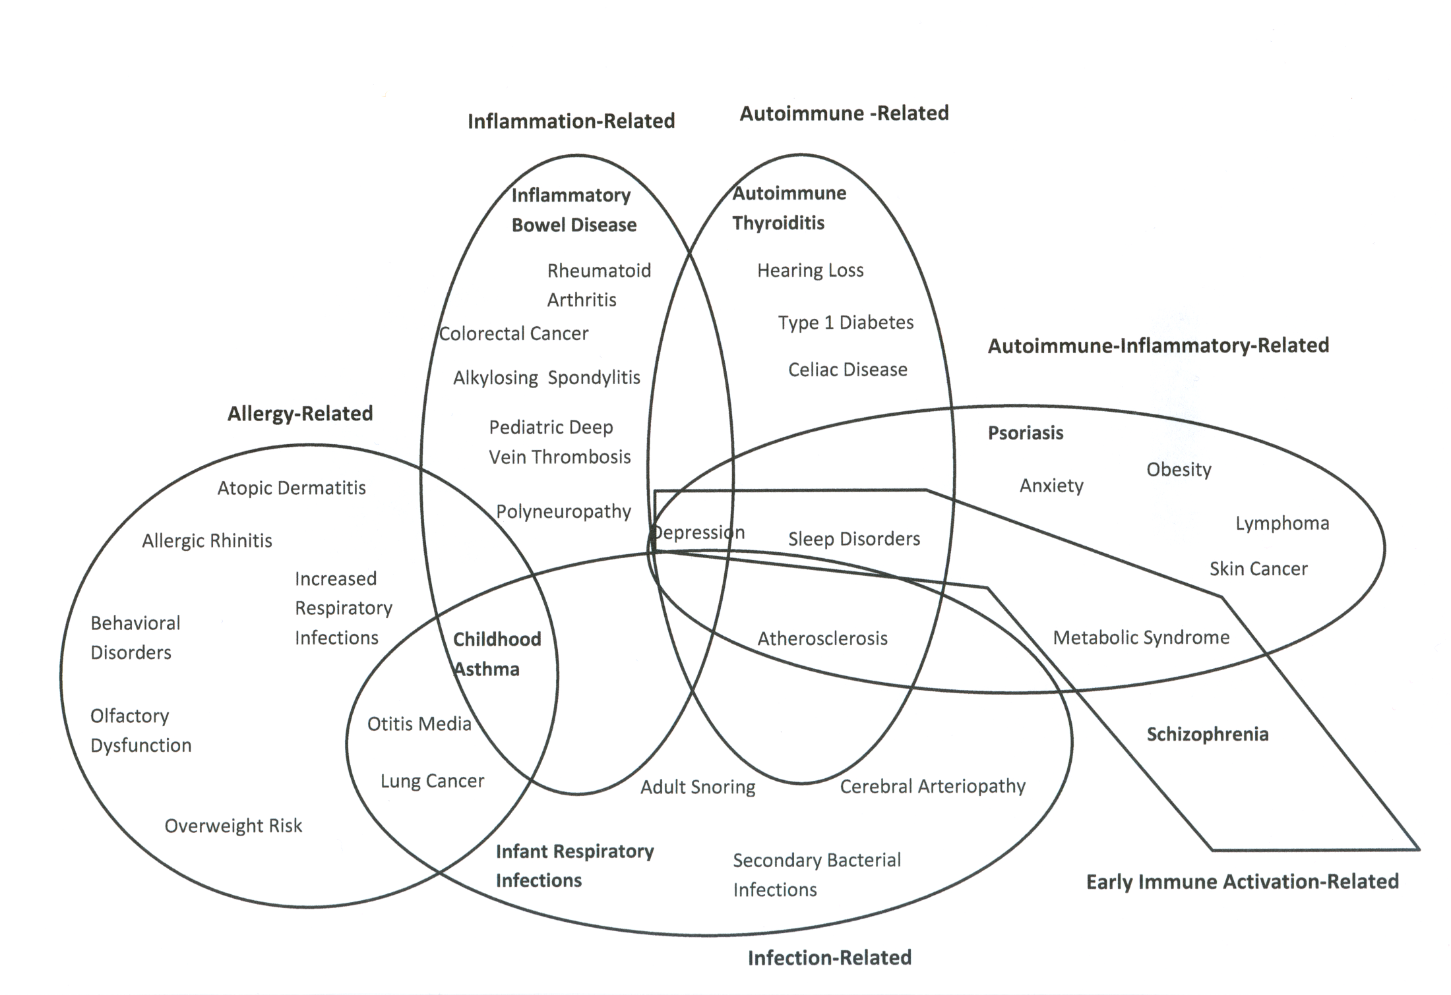
Chronic diseases are highly interconnected;
Depression, CVD, tissue-specific cancer,
sleep disorders.
metabolic disease and
sensory loss,
are common to immune
dysfunction-driven disease
patterns
9
Approximately one quarter
of children in certain developed
countries have
immune-based chronic diseases
Dietert and Zelikoff, 2009
Curr Pediatr. Rev.
Diagram from: Dietert, DeWitt, Germolec and Zelikoff , Environ. Health Perspect. 118:1091-9, 2010

Slide 10
Two More Immune-Driven Chronic Disease Networks
10
TYPE 1 DIABETES | CELIAC
Celiac disease | Osteoporosis (& fractures)
Autoimmune thyroiditis | COPD (men)
Endometrial cancer (women) | Specific G.I. tract cancer
Depression and anxiety | Depression (women)
Hearing loss | Hearing loss
Eating disorders | Eating disorders (women)
Cardiovascular disease | Cardiovascular disease
Hypertension | Sarcoidosis
Osteopenia | Restless leg syndrome
Addison’s disease | Liver Cirrhosis
Vitelligo | Recurrent Miscarriage (women)

Slide 11
EDCs and Critical Windows of Immune Vulnerability
(Interference in real-time maturation and/or epigenetically-programmed later-life malfunction)
11
Conception
Birth
2 yrs
Prenatal
Postnatal
TCDD (Dioxin)
Thymocyte maturation
Thymocyte apoptosis
Altered regulatory populations
Pb (Lead)
T helper imbalance
Allergy; Allergic inflammation
T helper and dendritic cell maturation
Bisphenol A (BPA)
Mucosal immune-gut microbiome
Leaky gut
inflammation
Polychlorinated biphenyls (PCBs)
Allergic
sensitization;
Skewed adaptive
responses
T cell and innate immune maturation

Slide 12
Examples of specialized populations of
resident macrophages in different tissues*
12
Organ or tissue | Population(s)
Liver | Kupffer cells
Lung | Alveolar macrophages
Brain | Microglia
 | Astrocytes
Fat | Preadipocytes
Gut | Intestinal macrophages
Kidney | Mesangial phagocytes
Cardiovascular | Monocytes
 | Perivascular macrophages
Reproductive organs | Testicular macrophages
 | Uterine macrophages
Placenta | Placental macrophages (Hofbauer cells)
Bone | Osteoclasts
* These residents affect tissue homeostasis, dysfunction, and pathology

Slide 13
Most EDCs Produce Problematic Unresolved Inflammation
13
Asthma,
Atherosclerosis,
Prostate enlargement, cancer
Bronchial and other
tissue inflammation
BPA
Male infertility,
Neurobehavioral alterations
Cardiovascular disease
Testicular, brain and other
macrophage-driven
inflammation
Pb
Prostastis, Reduced sperm
production
Vinclozolin
Prostate inflammation
Misregulation of
proinflammatory
cytokines
Testicular
autoimmunity,
Atherosclerosis
Cadmium
Asthma and
exacerbation of asthma
Acetaldehyde
Airway inflammation
Coplanar
PCBs
Proinflammatory cytokine production
Atherosclerosis
Arsenic
Proinflammatory cytokine production
Lipid peroxidation
Cardiovascular disease

Slide 14
14
The Predominate Gene Network Changes for
BPA and Phthalate Exposure Involve Inflammation
A recent study of genes altered by both
BPA and Phthalates found that 5 of the top 10 gene
networks are involved with inflammation.
See: Sher Singh and Steven Shoei-Lung Li ,
Bisphenol A and phthalates exhibit similar toxicogenomics and health effects,
Gene 2012, 494(1):85-91.

Slide 15
15
Inadequate Safety Testing of Chemicals and Drugs
Based on current causes of global mortality, the top priority for regulated safety testing of chemicals and drugs should be to reduce the risk of NCDs (Chronic Diseases). But it is not! In fact, required safety testing has little relevance to risk of chronic disease.
Question Posed to FDA Drug Safety Evaluators:
(at a May 2011internal seminar)
What safety data do you require for new drugs that are relevant for the risk of childhood immune dysfunction-based diseases such as
…..Childhood asthma?
.…Type 1 diabetes?

Slide 16
Conclusions
16
EDCs are a serious threat to health and wellbeing.
The predominate outcomes of EDC exposure are: NCDs (aka Chronic Diseases and Conditions).
Chronic Diseases are highly interrelated via comorbidities.
Misregulated inflammation linked with immune dysfunction is required to produce and/or maintain chronic diseases.
The developing immune system is a primary target for immune dysfunction-driven chronic diseases.
Current required safety testing is inadequate to protect against developmental immunotoxicity (DIT) and risk of chronic diseases.

